Slide 1

Operational Excellence Pays For itself
Presented by
Art Smalley
President
Art of Lean, Inc.

Slide 2
Outline For Today’s Discussion
Introduction
First principles of TPS / Lean
Roadmaps
Requested topics
General summary advice
Final Q&A

Slide 3
Introduction / Background
Employed by Toyota Motor Corporation in Japan
  Kamigo engine plant – Ohno’s TPS model
  Overseas plant start-up support work
Director of Lean Donnelly Corporation
  5-year Lean transformation effort
  Multiple awards and recognition
Manufacturing Consultant McKinsey & Company
  Multiple engagements & sectors
  Thought leadership & knowledge development
President Art of Lean, Inc.
  Serve clients implementing Lean
  Write articles and books
  Speaking engagements
  Training / improvement workshops

Slide 4
First Principles / 8 Questions
3. How will you build in quality?
1. How will you satisfy the customer and obtain a profit?
4. How will you deliver 100% JIT?
5. How will you stabilize the process availability to 100%?
2. What are your main problems in production?
6. How will you standardized work 100%?
7. How will you develop natural work team leaders?
8. How will your company sustain and improve?

Slide 5
Customer Value and Profit – 1/3
Supplier requirements
100% on time
100% quality
Short lead time
Flexibly respond to changes
Price/Cost improvements
Spirit of cooperation

Slide 6
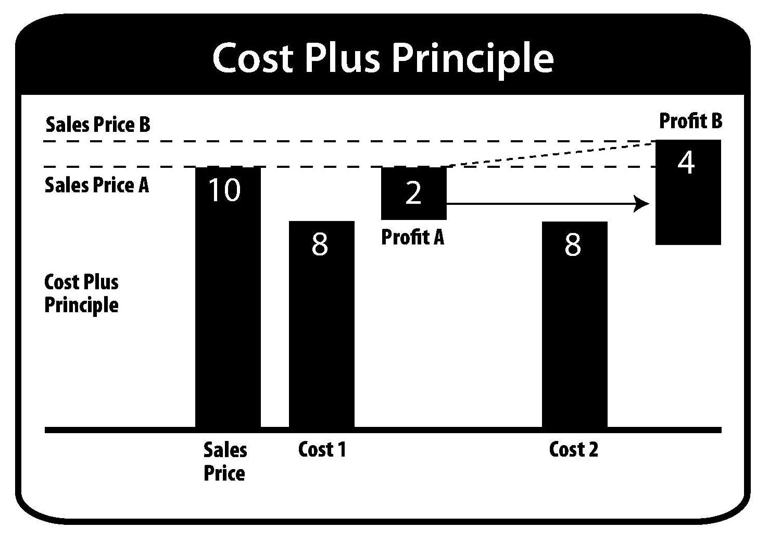
Customer Value and Profit – 2/3

Slide 7
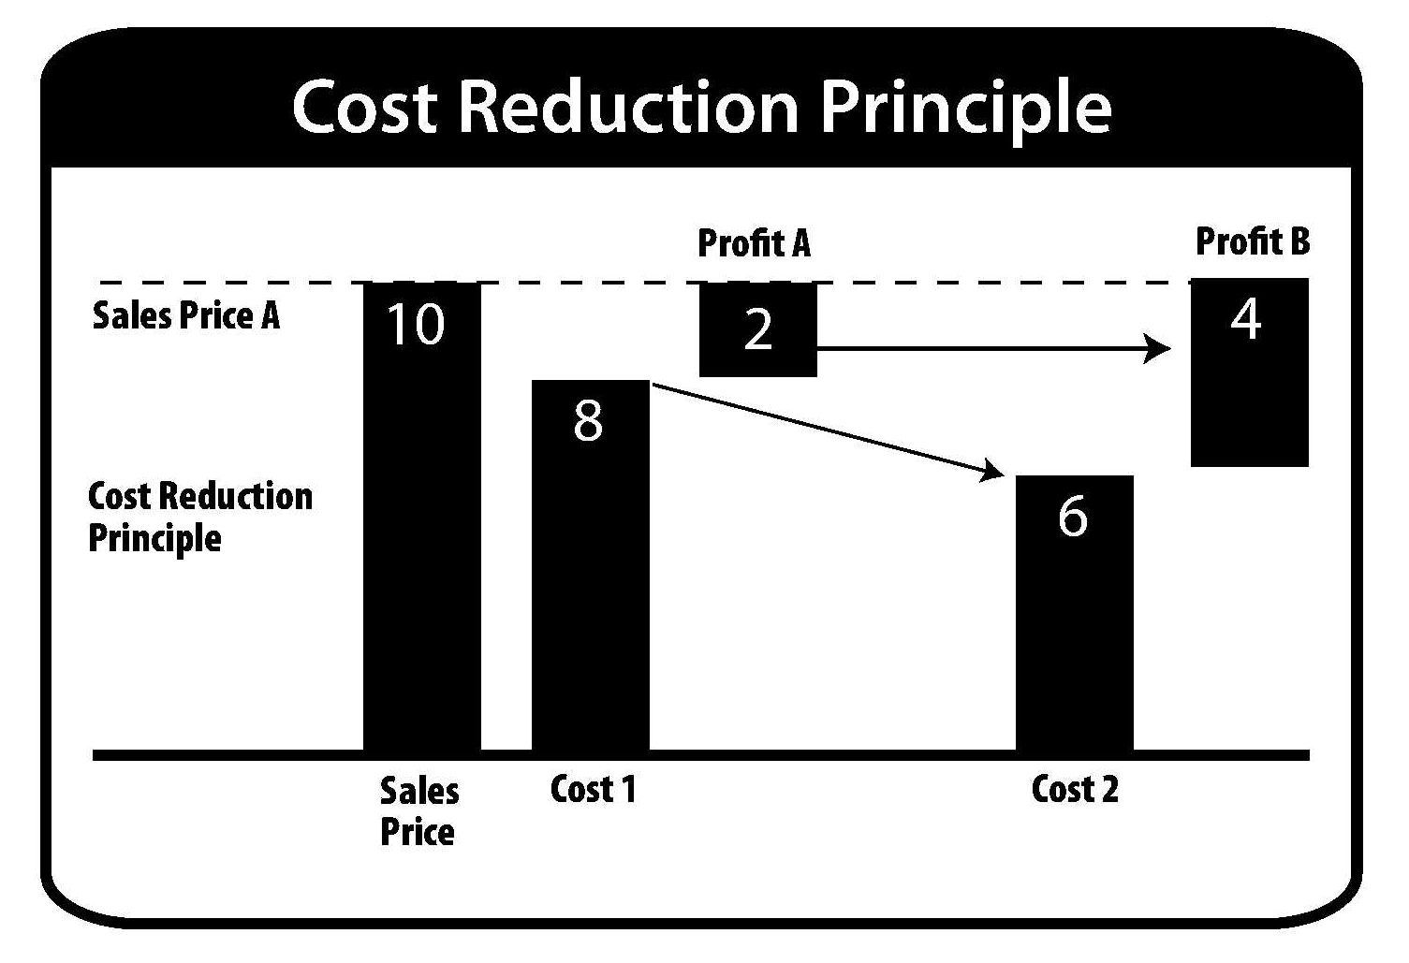
Customer Value and Profit – 3/3

Slide 8
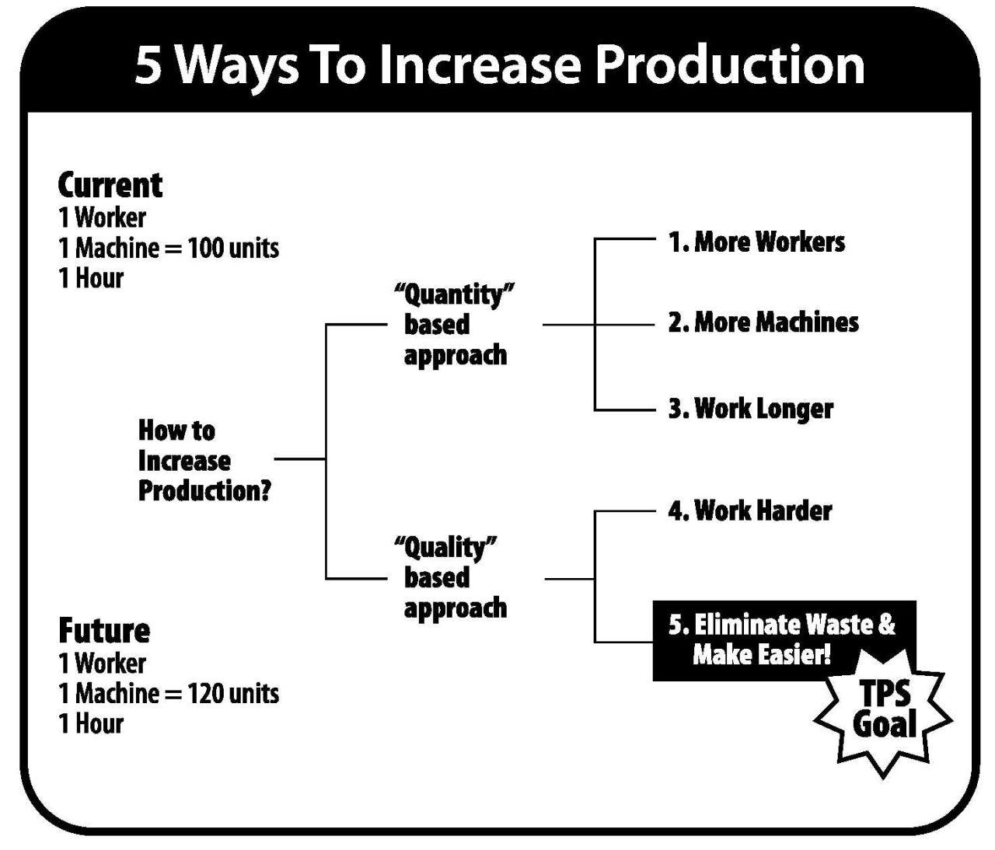
Lean Excellence is Free

Slide 9
First Principles / 8 Questions
3. How will you build in quality?
1. How will you satisfy the customer and obtain a profit?
4. How will you deliver 100% JIT?
5. How will you stabilize the process availability to 100%?
2. What are your main problems in production?
6. How will you standardized work 100%?
7. How will you develop natural work team leaders?
8. How will your company sustain and improve?

Slide 10
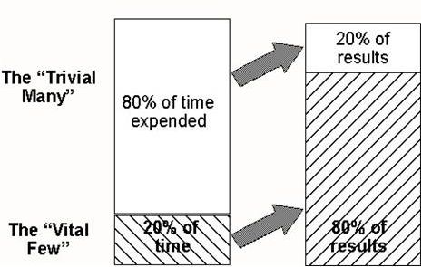
2. Vital Few Versus The Trivial Many
What to work on with so many problems?
Magnitude of Problem
# of incidents
“In problem solving you have to learn to sort out the vital few from the trivial many.”
- Joseph M. Duran

Slide 11
First Principles / 8 Questions
3. How will you build in quality?
1. How will you satisfy the customer and obtain a profit?
4. How will you deliver 100% JIT?
5. How will you stabilize the process availability to 100%?
2. What are your main problems in production?
6. How will you standardized work 100%?
7. How will you develop natural work team leaders?
8. How will your company sustain and improve?

Slide 12
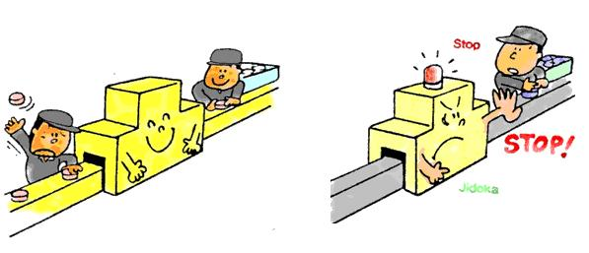
3. Build-in-Quality (Jidoka) 100%
Proper work instructions, standards, and training
Error proofing against simple known mistakes
High process capability (1.33 – 2.0 Cpk)
Stop the line capability (Man or Machine)
Quality control system with layered audits and feedback

Slide 13
First Principles / 8 Questions
3. How will you build in quality?
1. How will you satisfy the customer and obtain a profit?
4. How will you deliver 100% JIT?
5. How will you stabilize the process availability to 100%?
2. What are your main problems in production?
6. How will you standardized work 100%?
7. How will you develop natural work team leaders?
8. How will your company sustain and improve?

Slide 14
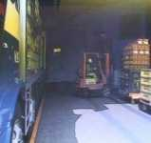
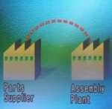
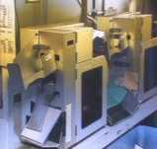
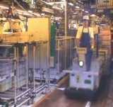
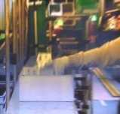
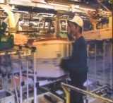
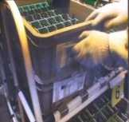
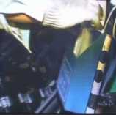
4. Just-in-Time 100% - 1
8. Signal to
supplier
1. Unload
Truck
7. Sort kanban
2. Deliver to line
6. Pick up from post hourly
3. Unload
Parts
5. Put kanban in post
4. Detach kanban

Slide 15

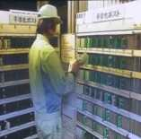
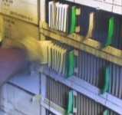
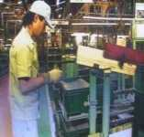
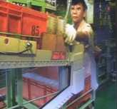
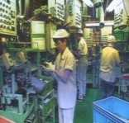
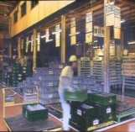
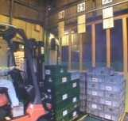
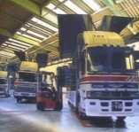
4. Just-in-Time 100% - 2
1. Print out kanban
2. Load Heijunka box
3. Pull at timed interval
4. Deliver to line
5. Receive instruction
6. Make parts as signaled
7. FG Store
8. Shipping Lane
9. Load truck for ship

Slide 16
First Principles / 8 Questions
3. How will you build in quality?
1. How will you satisfy the customer and obtain a profit?
4. How will you deliver 100% JIT?
5. How will you stabilize the process availability to 100%?
2. What are your main problems in production?
6. How will you standardized work 100%?
7. How will you develop natural work team leaders?
8. How will your company sustain and improve?

Slide 17
5. 100% Available When Needed*
100%
15%
Downtime, minor stops, change over time, quality checks
85%
100% available when needed
during this period of time
*Machining example

Slide 18
First Principles / 8 Questions
3. How will you build in quality?
1. How will you satisfy the customer and obtain a profit?
4. How will you deliver 100% JIT?
5. How will you stabilize the process availability to 100%?
2. What are your main problems in production?
6. How will you standardized work 100%?
7. How will you develop natural work team leaders?
8. How will your company sustain and improve?

Slide 19
6. Standardize Work Practices
Kaizen
Build a new improved standard
Standardized Work
Balance labor to takt time
Job Instruction
Training: MS, KP, RY
Work Standards
Technical basis

Slide 20
First Principles / 8 Questions
3. How will you build in quality?
1. How will you satisfy the customer and obtain a profit?
4. How will you deliver 100% JIT?
5. How will you stabilize the process availability to 100%?
2. What are your main problems in production?
6. How will you standardized work 100%?
7. How will you develop natural work team leaders?
8. How will your company sustain and improve?

Slide 21
7. Develop Work Team Leaders
1. Knowledge of work
-(e.g. how we do things)
Knowledge of responsibility
-(e.g. what we need to do by when)
Skill in instructing
-(e.g. how to teach effectively)
Skill in leading
  -(e.g. how to handle job relations)
Skill in improving
-(e.g. how to make improvements )

Slide 22
First Principles / 8 Questions
3. How will you build in quality?
1. How will you satisfy the customer and obtain a profit?
4. How will you deliver 100% JIT?
5. How will you stabilize the process availability to 100%?
2. What are your main problems in production?
6. How will you standardized work 100%?
7. How will you develop natural work team leaders?
8. How will your company sustain and improve?

Slide 23
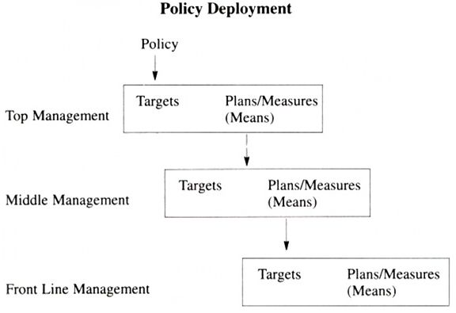
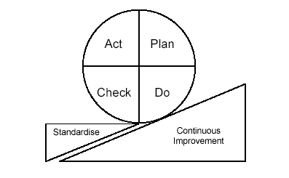
8. Sustain and Improve
+
Annually
Quarterly
Monthly
Weekly
Daily
Shift
Takt Time

Slide 24
Shingo Prize Organization
Respect every individual
Lead with humility
Seek perfection
Assure quality at the source
Flow and pull value
Embrace scientific thinking
Focus on the process
Think systematically
Create constancy of purpose
Create value for the customer

Slide 25
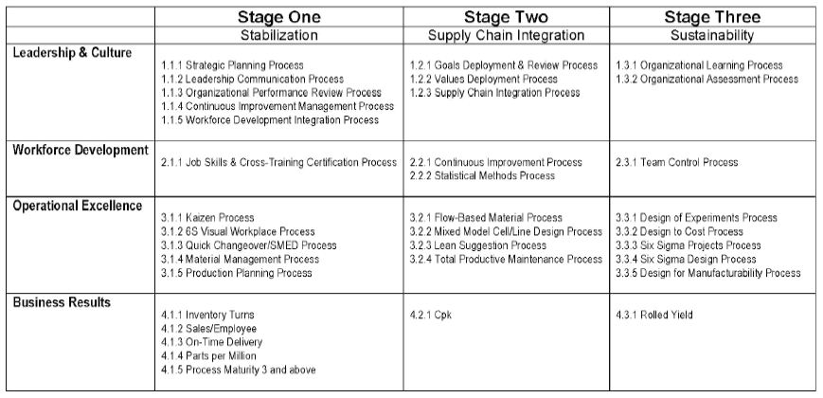
SEA Roadmap

Slide 26
Results vs. Process
Benefits
Increased profits
Improved quality
Enhanced productivity
Reliable delivery
Improve safety & morale
High
Zone 2
Zone 4
Med.
Roadmap / Process
Zone 1
Zone 3
Low
Low
Med.
High
Results

Slide 27
Requested Topics
Learning from other industries
Benchmarking
Building early momentum and success
Obtaining buy in
Unique cases / we are special
Degrees of outsourcing
How fast is fast enough?
Reports of Toyota’s Death

Slide 28
General summary advice
Keep in mind the 8 principles
Follow your roadmap & check results
Strategy & execution linkage
Senior leadership involvement
Company wide focus
Relentless execution / PDCA cycle
Kaizen & Respect for people

Slide 29
Final Q&A

Slide 30
Appendix

Slide 31
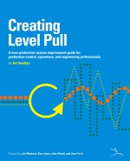
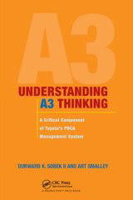
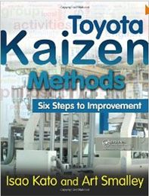
Art Smalley / Art of Lean, Inc.
http://www.artoflean.com

